Slide 1
CE889 Individual Project
Registration Number: 1804162

Slide 2
Data Collection Process
To collect the data to be used for the neural network, I spent a while playing the game on the data collection mode. In order to ensure that my data was as consistent as possible, I attempted to make sure that my inputs for the game remained consistent. I tried to avoid over-shotting my target; needing me to correct myself, as this would lower the quality of the data for that run.
I tried to ensure that I would always land as flat as possible, as this results in a higher score for the run and a higher average score from the neural network would mean that it performs better.
Lastly, I tried to lose as little as possible during my data collecting. This is a problem as data related to a game that is lost will still be trained on, so the neural network will essentially learn to lose.

Slide 3
Data Management
Pre-Processing
Partitioning
Raw data is input from a CSV file.
Removal of CSV rows without exactly four cells of data, as two inputs and two outputs are required.
Removal of any duplicate rows. This helps to prevent some overfitting due to the network training more on specific data.
Normalization in the form of re-scaling all values between 0 and 1 using min-max normalization. The minimum and maximum values are used in order to normalize and de-normalize the data for playing the game.
The pre-processed data is then exported to a new CSV file.
Data is read from the CSV file and stored in the object class.
This data is partitioned into three sets:
Training (70%)
Validation (15%)
Testing (15%)
The validation set is used to judge parameters against and optimise them, as this is data that is not being trained on, however, is monitored every epoch.
The testing set is used to test the final model after all parameters are tuned. Using this unseen data ensures the parameters used aren’t tuned only towards the validation set

Slide 4
Network Architecture
The network consists of a selection of key functions that perform the updating of weights for the network, and then some additional functions that aid in returning outputs such as weights for the game, or test data results.
In my network, biases are assigned in the same way nodes are, however are skipped when it comes to updating the weights behind them; as they should have a fixed activation value of 1.
The first key function in my network is the ‘feed_forward()’ function. This is the function that sets the value of the input layer neurons to the desired inputs and performs the feed-forward algorithm to calculate the activation values of each of the neurons in the hidden layer and output layer.
The next function is the ‘backwards_propagate()’ function. This is the function that calculates the gradients of every neuron not in the input layer to be used to update the weights. In order to reduce the amount of duplicate code, I moved half of the gradient calculation formula to another function: ‘error_calculation’. This function performs the part of the gradient formula that is unique to the different layer types, before storing this in a temporary variable in each neuron. This then allows ‘backwards_propagate()’ to finish the formula in the same way for each neuron; regardless of if it’s from the output layer or the hidden layer.
The last function is the ‘weight_update()’ function. This function calculates the delta weights within the network, before using them to adjust the existing weights by summing them. This function looks at the existing delta weight values, and multiplies them with the momentum factor (alpha) in order to apply momentum to the training. The first run will always have a momentum of 0, however as the training proceeds the delta weight will adjust with the current state of the network.

Slide 5
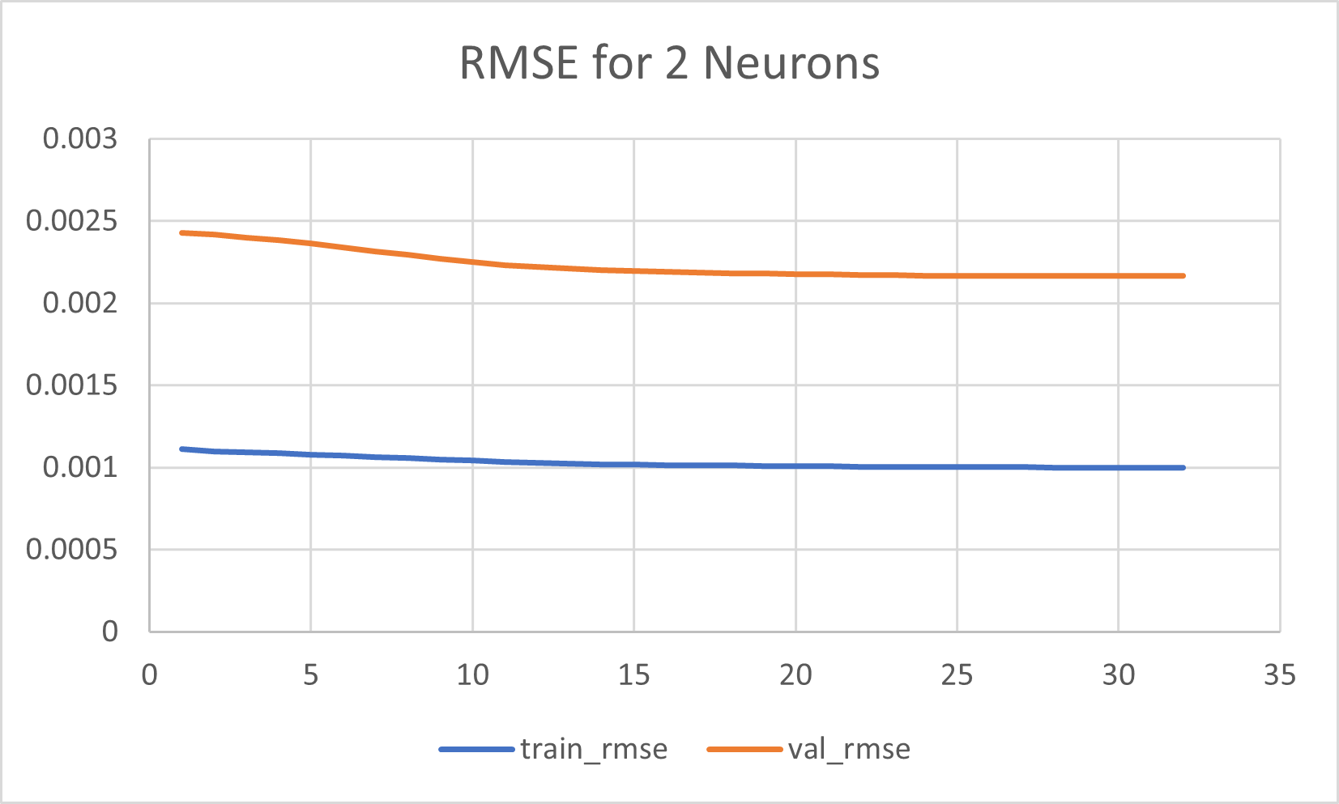
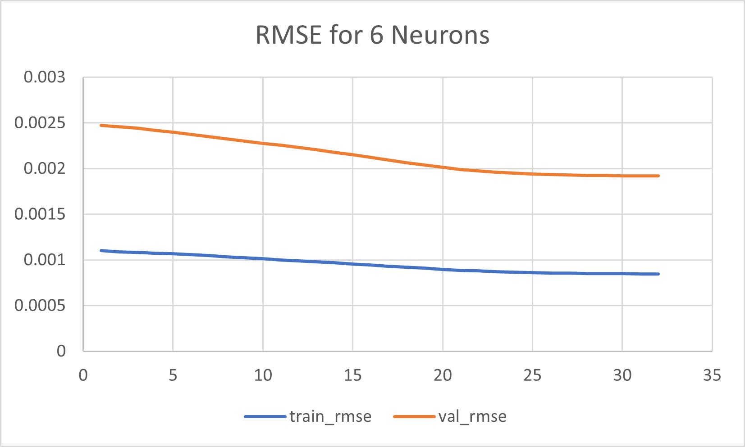
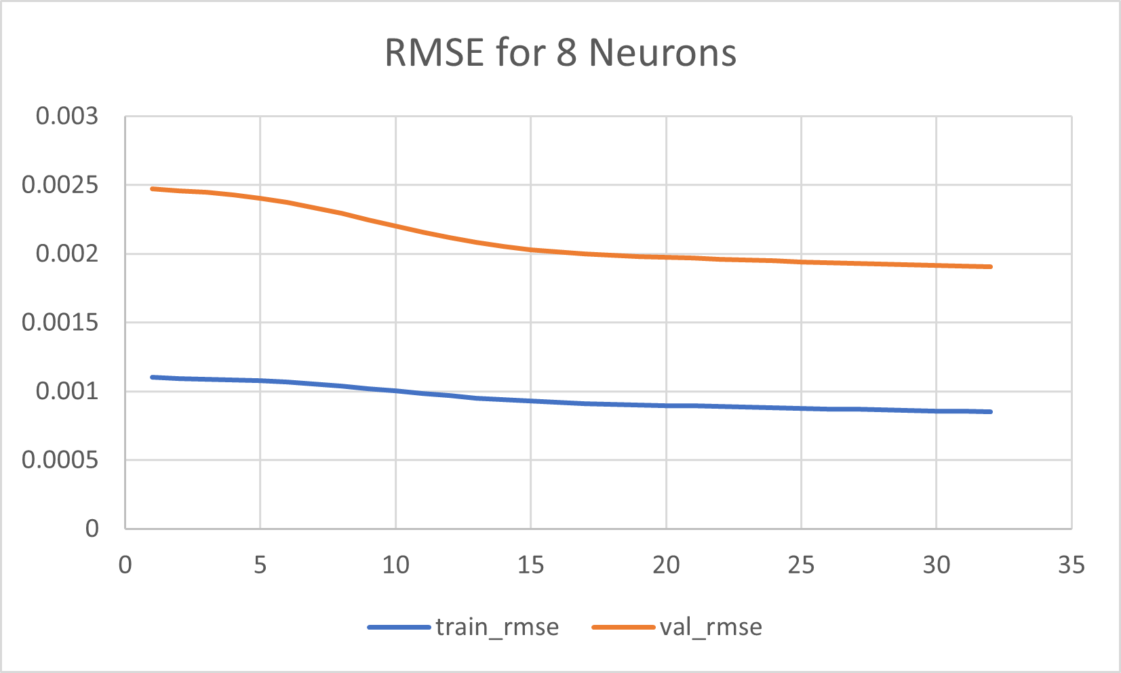
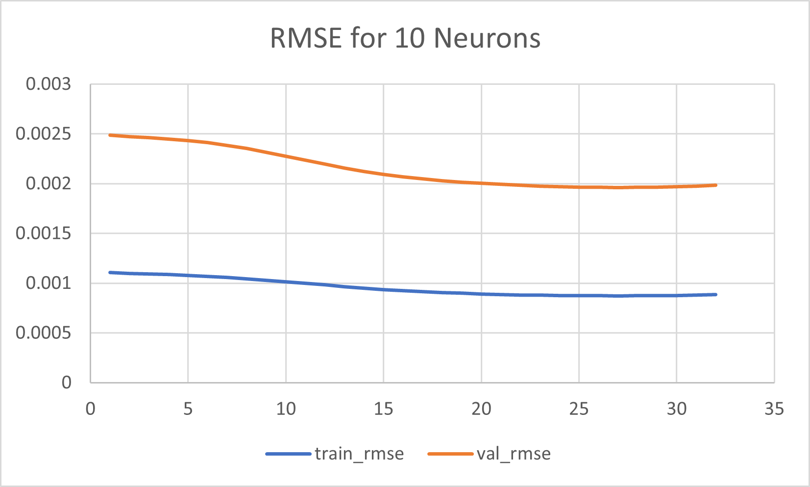
Hidden Layer Size Comparison
In order to decide on a hidden layer size, I had to compare the RSME values for each of the hidden layer sizes I checked. Because the weights are initialized randomly, all graphs made regarding a configuration of parameters or sizes need to be made a few times, to make sure that the behaviour is somewhat consistent. I also had to decide based on how long the network took to train, as my network started to take a while to train when selecting above four neurons.
My final network size was using four neurons in my hidden layer.

Slide 6
Chosen Parameter Values
Momentum Factor (Alpha):
0.05
Regularization Rate (Lambda):
0.6
Learning Rate (eta):
0.01
Epochs:
32
Parameters were chosen by first finding a hidden layer size that seemed to perform the best, before comparing the RMSE of the validation set for each epoch.
I would take the saved RMSE values from the file, and plot them in a graph to compare between them easier than just reading from the output (in the same way that had been done for deciding the number of hidden neurons).
As with before, I tried to perform multiple runs with each combination of parameters to get an average behaviour of the network.

Slide 7
Parameter Effect
Epochs:
The number of epochs was set as 32, as I wanted to try and include as many as possible without risking my RMSE rising. If I set it too high then the model began to overtrain and the RMSE would start rising. I would allow for small rises in RMSE as depending on what weights had been generated this sometimes happened, but if it continued to rise through multiple epochs then I chose a different value. If I had implemented early stopping, this could have been easier to avoid.
Alpha:
The momentum of the network allows the network to have a better chance of avoiding a local minimum if it is shallow enough by continuing the current trend of the weights even when they change within the weight update function; stopping the change from halting. However, too high of a momentum value can result in the RMSE very quickly increasing between epochs.
Lambda:
The regularization rate attempts to improve the network by trying to move the weights as close to 0 as possible. This would hopefully result in the mean of the weights being more or less 0, with the frequency of weights of a value dropping the further it is from 0. Too low of a lambda value will result in the model being at risk of overfitting, and too high will result in underfitting.
Learning Rate:
The learning rate is the parameter that how much the model changes in response to the calculated error each time the weight update function is called. Lowering the learning rate would help to make the model more stable but could result in the model taking much longer to train and becoming trapped in a local minimum. A learning rate that is too high can result in much of the data not being adjusted for correctly, so the final model will produce very sub-optimal results.

Slide 8
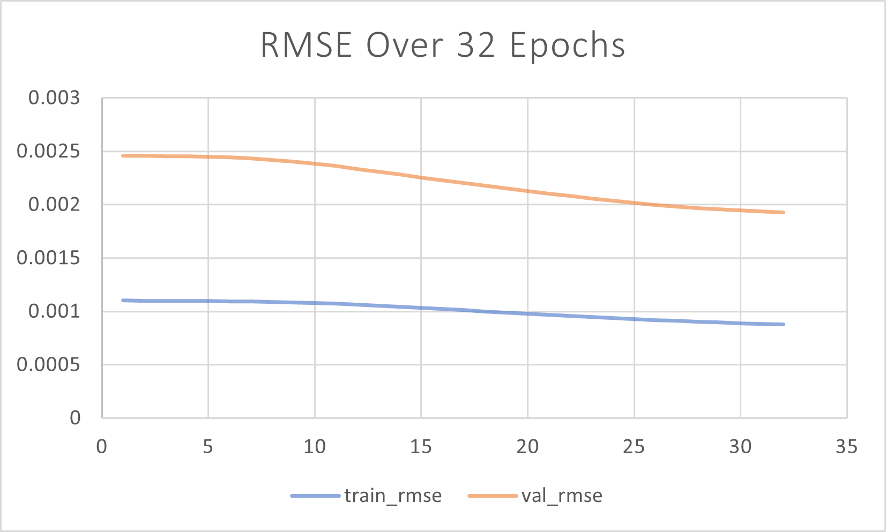
RMSE
The graph shows some overfitting, as the RMSE values for the training set are about twice as low as the RMSE values for the validation set.
The train set starts off as low but does not seem to improve much. The validation set has a sharper decline however also starts to plateau at around 30 epochs.
If I had time to implement early stopping, it is likely from this graph that there would not have been many more epochs than what has been used.

Slide 9
Extra Implementations
Formatting the printing of the neural network and its neurons, to allow for easier monitoring of the status of the network at any time and to allow for me to verify the output is as it should be by calculating by hand.
Calculating the average percentage error for each row in the test set, allowing me to easily compare how far off a set of two outputs are two the corresponding expected values.

